Slide 1
Forma Automation Framework Presentation
By :
- PARTHIBAN R

Slide 2
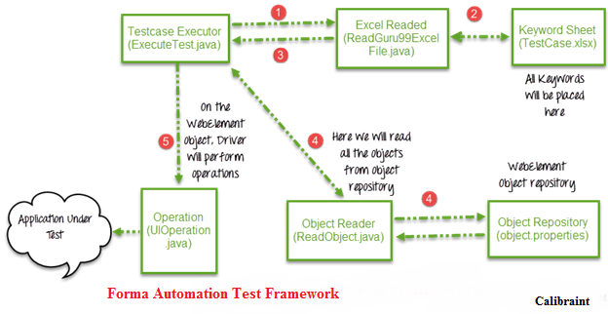
All operations and instructions are kept in an external source.(Excel Sheet)
Here is how the complete framework works as in the below image.

Slide 3
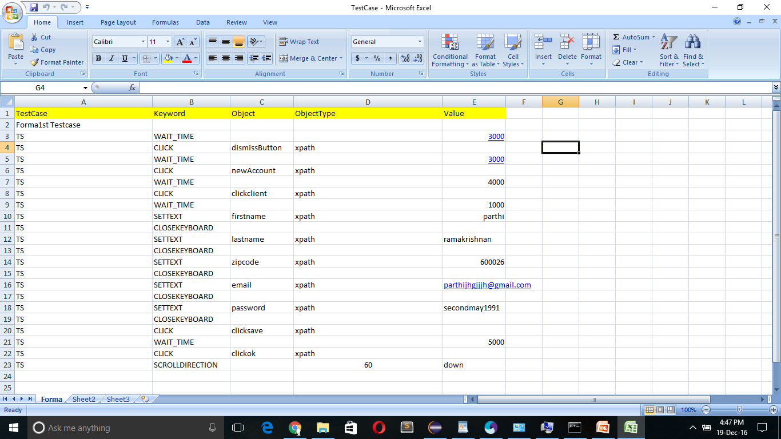
The Driver Execute test.java will call Read excel file .java
Read Excel file .java has POI Script to read data from excel.
Read Excel file .java will read data from Forma_TestCase.xlsx

Slide 4
Test Case Name
Keywords
Object Name
Object Type
Test Data

Slide 5
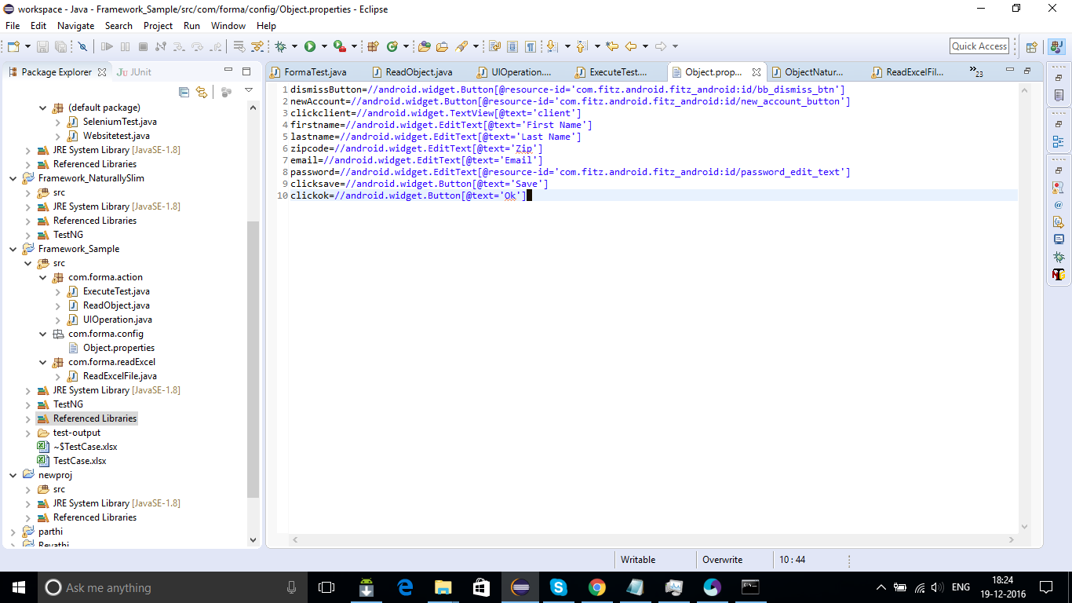
Read Excel file.java will pass this data to the driver script Execute Test.java
For all of our UI Web Elements we need to create an object repository (where we will pass their element locators) as below, Eg : Xpath, Class, etc.

Slide 6
Execute Test.java will read the entire object repository and store it in a variable.
To read this object repository we need a ReadObject class which has a getObjectRepository method to read it.
public class ReadObject
{
Properties pl = new Properties(); public Properties getObjectRepository() throws IOException
{
InputStream stream = new FileInputStream(new File(System.getProperty("user.dir")+"\\src\\com\\forma\\config\\Object.properties"));
pl.load(stream);
return pl;
}
}

Slide 7
Driver will pass the data from excel and object repository to UIOperation class.
UIOperation class has functions to perform actions corresponding to keywords like CLICK, SETTEXT, etc as mentioned in the Forma Testcase.xlsx
UIOperation class is a java class which has the actual implementation of the code to perform operations on web elements.

Slide 8
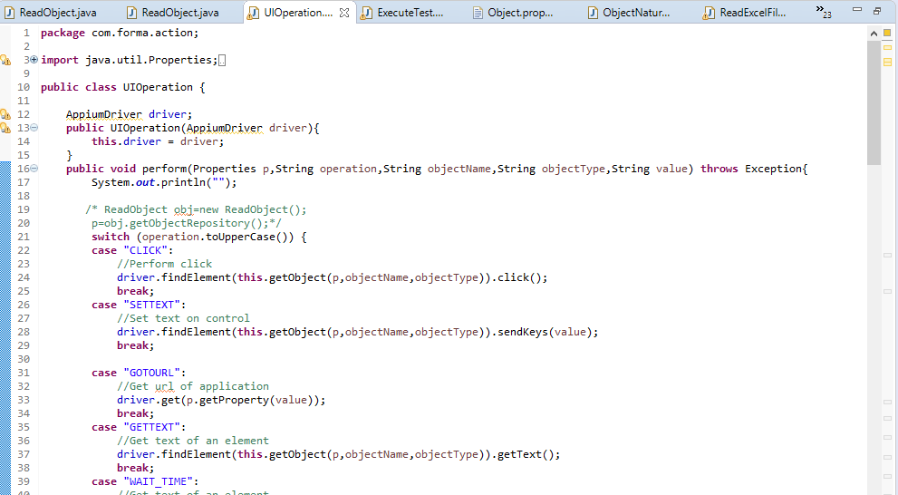

Slide 9
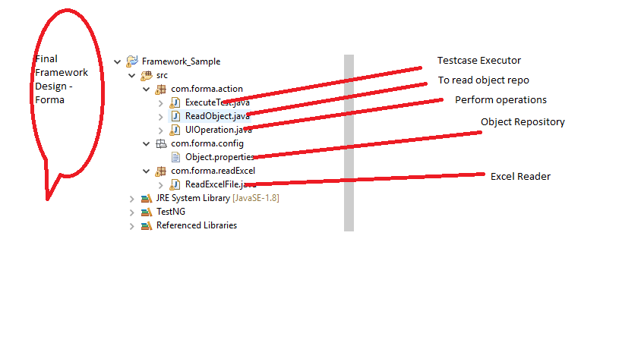

Slide 10
THANKING YOU

